Slide 1
Fall 2017 Training:
e-Resources
PM Session
SIRS Discoverer and Explora Resources
This project is made possible by a grant from the Institute of Museum and Library Services as administered by Pennsylvania Department of Education through the Office of Commonwealth Libraries, and the Commonwealth of Pennsylvania, Tom Wolf, Governor.

Slide 2
Learning Goals
At the end of this session you will be able to
Navigate SIRS Discoverer and utilize available tools
Navigate EBSCO Explora databases and use available tools
Elementary Student Search
Middle School Student Search
High School Student Search
Explora Educator’s Edition
Public Libraries
Locate lesson plans and activities to use in the library and classroom

Slide 3
SIRS Discoverer
From SIRS Discoverer Libguides Page:
ProQuest SIRS Discoverer is a multidisciplinary database for elementary and middle school learners, researchers, and educators covering curriculum areas such as current events, history, health, language arts, math, science, social studies, and technology. All newspaper, magazine and reference content is 100% full text, editorially-selected and indexed from over 2,200 reliable, high-quality domestic and international sources. The collection includes 9,000 integrated educational weblinks, and reference materials such as the Compton’s by Britannica encyclopedia and DK Eyewitness books.
ProQuest SIRS Discoverer supports differentiated instruction by providing Lexile scores, grade level reading , article read-aloud and language translation, age-appropriate article summaries, and automatically generated citations. Teacher and student materials are aligned with curriculum subject areas, research topics and homework help. User-friendly special database features such as “Animal Facts” “Nonfiction Books,” “Country Facts,” “Pro/Con Leading Issues,” “Science Fair Explorer,” and “Spotlight of the Month,” to further support the curriculum, while engaging students as they identify content needed for research, homework and classwork.
http://proquest.libguides.com/SIRSDiscoverer

Slide 4
Content By the Numbers
2,100+ sources
40,000 high quality images and graphics
500+ full text non-fiction books
9,000 monitored educational websites
3,000 biographies
3,000+ current and historical maps
400 Country, Province, and State facts
300+ editorial cartoons
5,600+ activities
http://proquest.libguides.com/SIRSDiscoverer

Slide 5
Curriculum Tools
Standards alignment with US and Common Core standards
Leading Issues
Animal Facts
Visual Literacy Activities
Non-fiction books
Spotlight of the Month
ReadSpeakerText to speech
Language translation
Graphic Organizers
Science Fair Explorer
Skills Discoverer
Lexiles and editorially assigned reading levels
Links to EasyBib
MLA and APA citation generator
Copy URL
Visual Browse
Social bookmarking
Student workbooks
http://proquest.libguides.com/SIRSDiscoverer

Slide 6
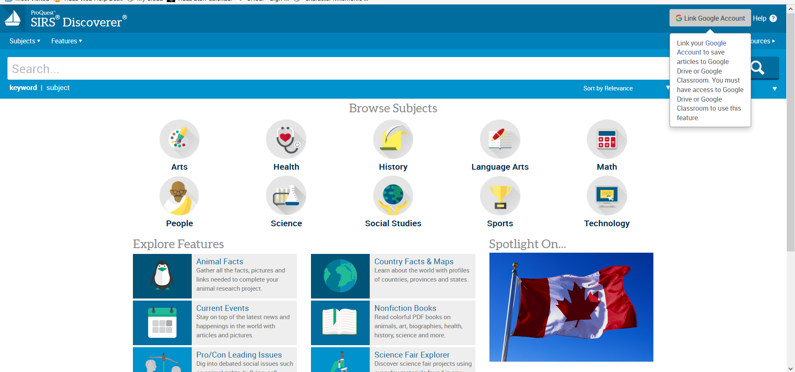
Google Drive and Classroom Integration

Slide 7
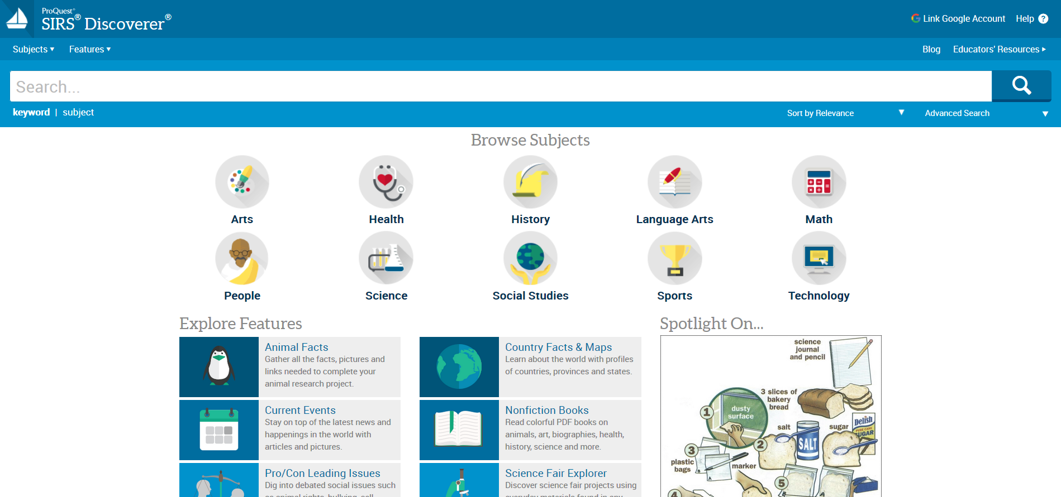
SIRS Discoverer Logo
The sailboat icon is on every page to easily navigate back to the homepage/landing page

Slide 8
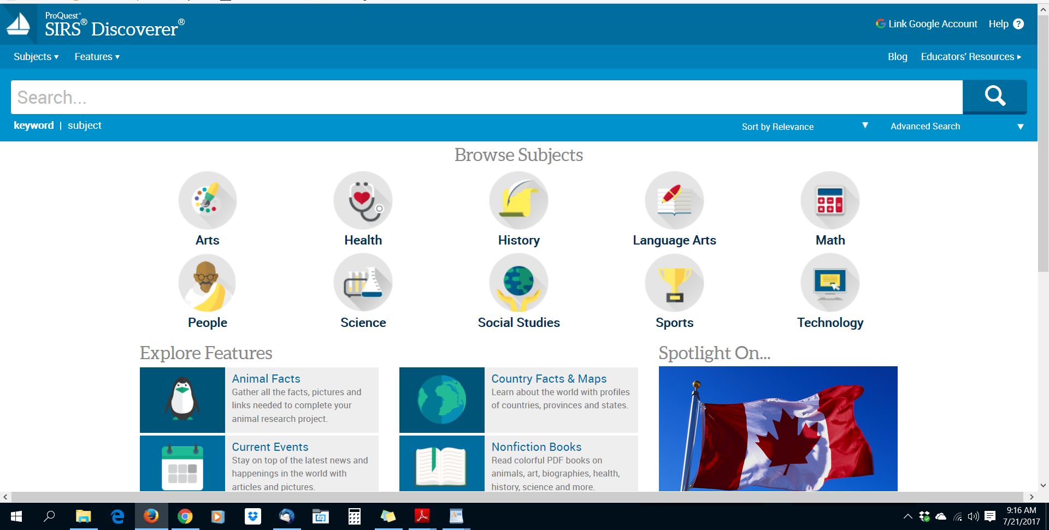
Navigation--Every Page
Help
Subjects
Features
Blog
Educators’ Resources
Search
Sort by
Advanced Search

Slide 9
Navigation--Footer
Mobile
Curriculum Standards

Slide 10
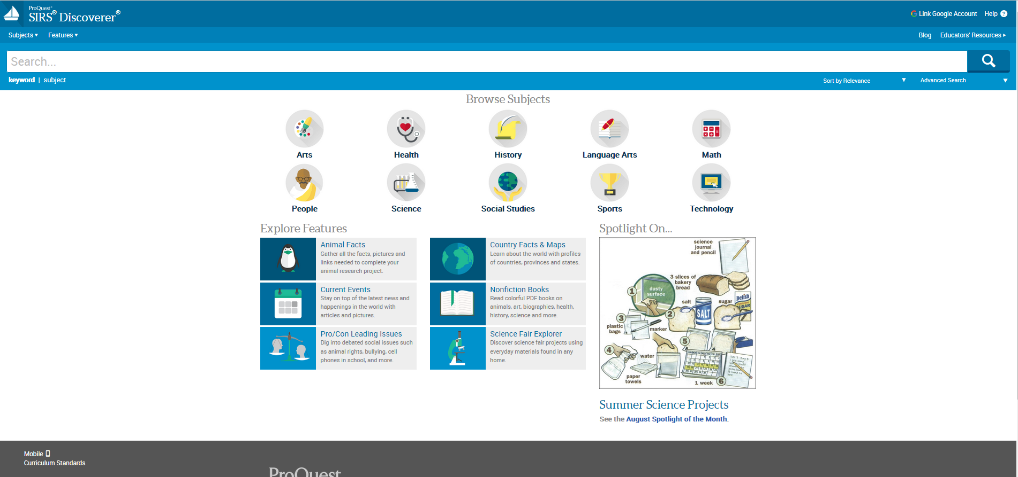
Home Page

Slide 11
Keyword Search
Boolean operators
AND, OR, NOT
Truncation
farm* -->farmers, farming
Phrase searching
“Climate change”
Natural language
“Is there life on Mars?”

Slide 12
Subject Search
Use Subject search when you have a specific search topic

Slide 13
Browse Subjects--Visual Search

Slide 14
Sort By Options
Sort by Date
Sort by Relevance
Sort by Lexile (high to low)
Sort by Lexile (low to high)

Slide 15
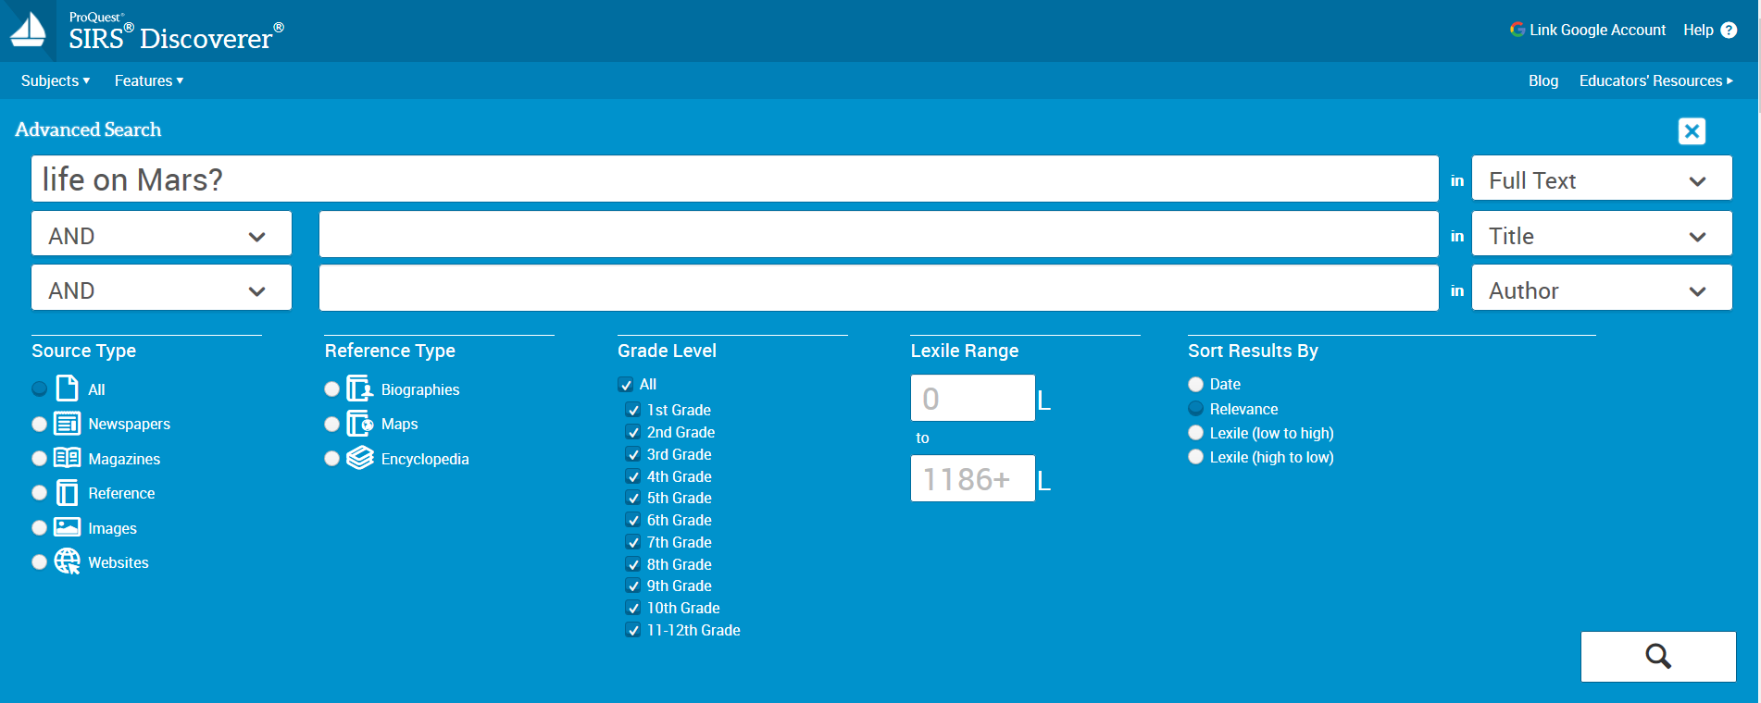
Advanced Search
Notes:
Advanced search feature

Slide 16
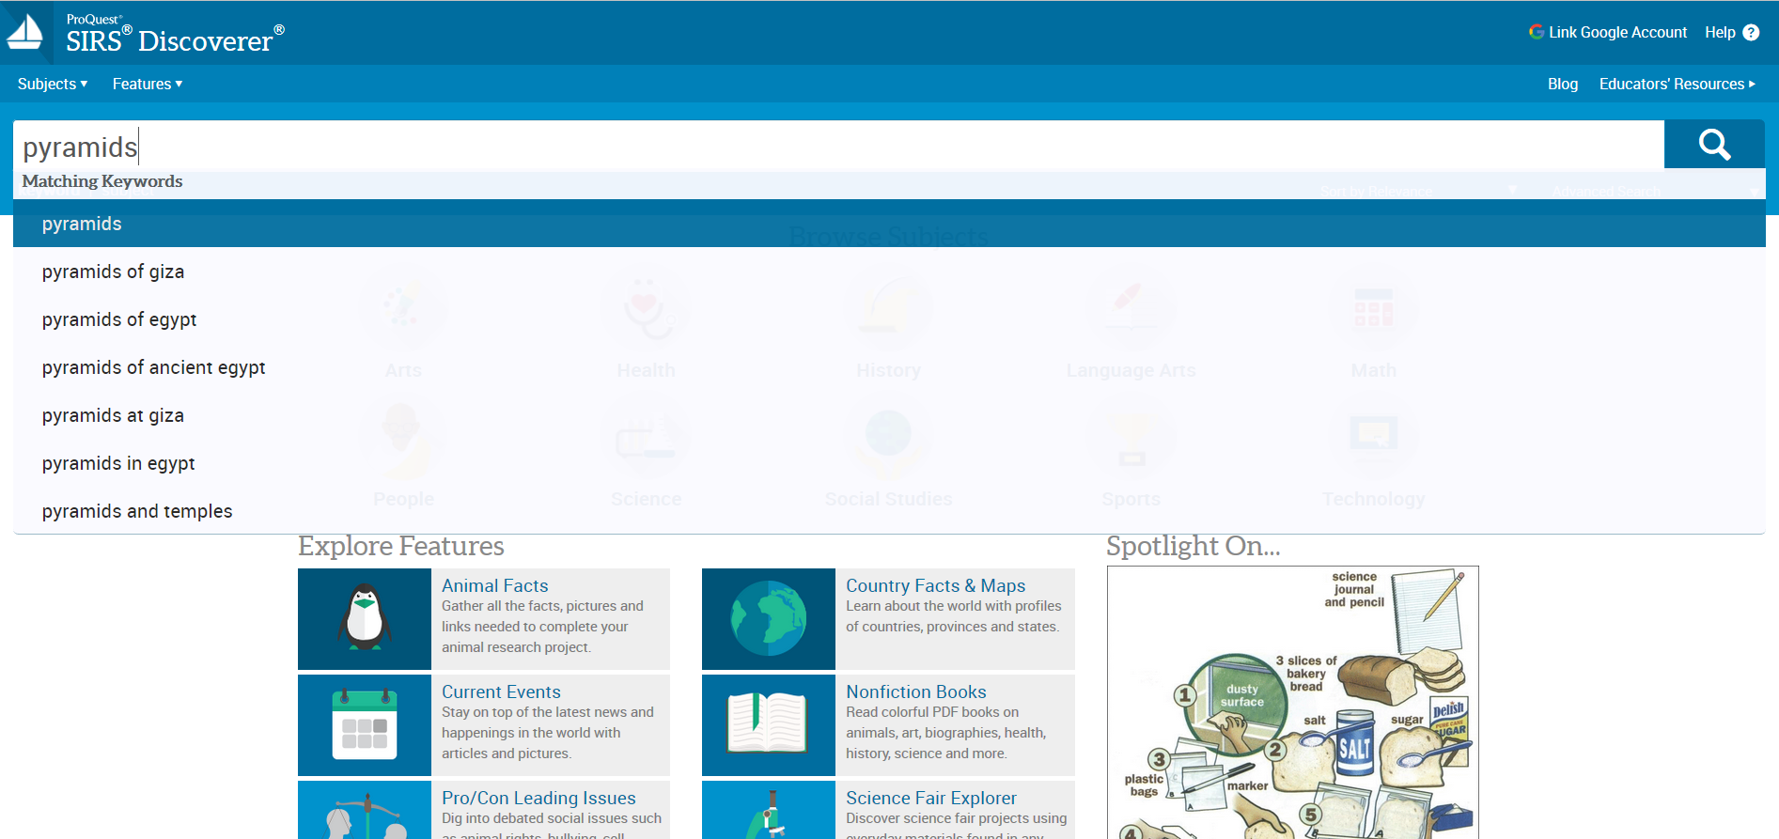
Let’s Search!
Notes:
Misspelling a search term—SIRS will try to autocorrect and display closely matched search terms (pryamids → pyramids)

Slide 17
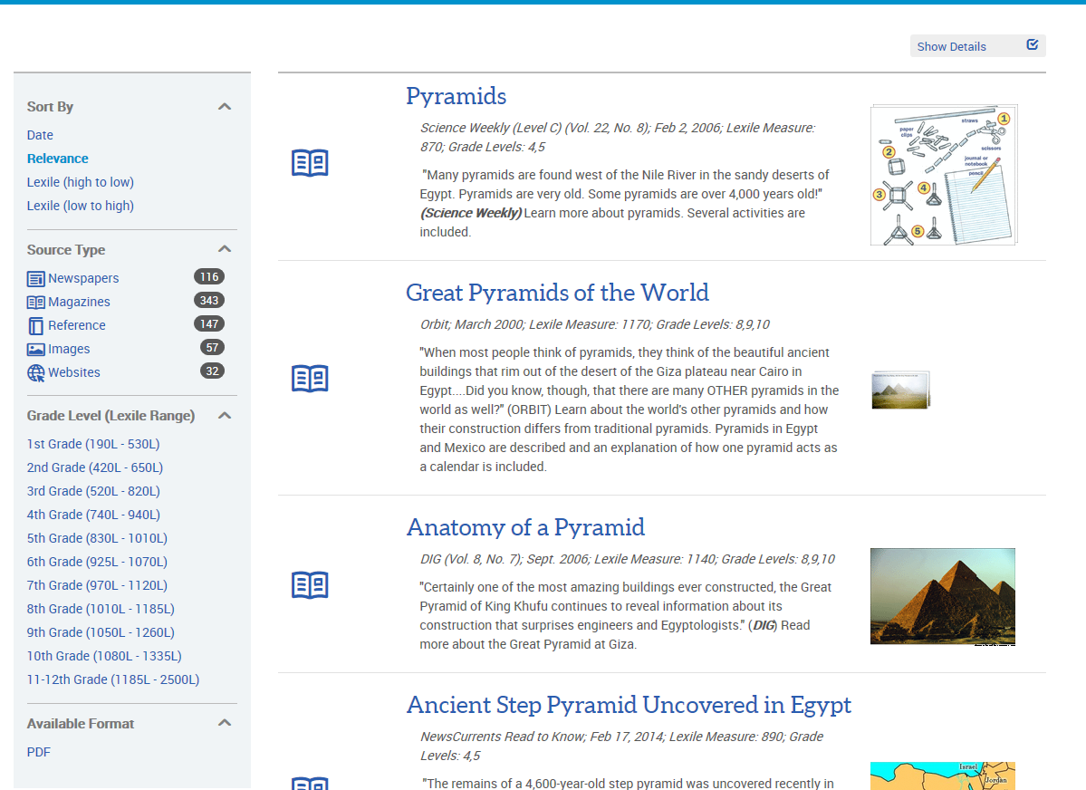
Search Results-Left Side
Sort By
Source Type
Grade Level
Available Format

Slide 18
Search Results—Results List
Source type
Lexile
Grade Levels
Source Information

Slide 19
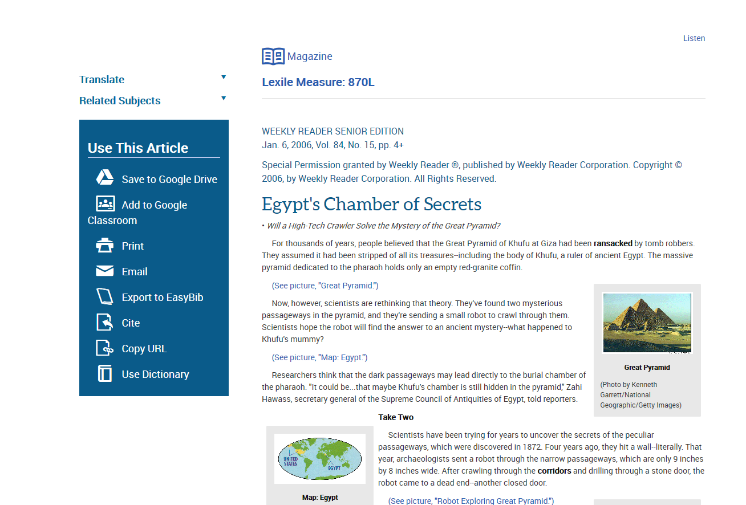
Full Text Preview

Slide 20
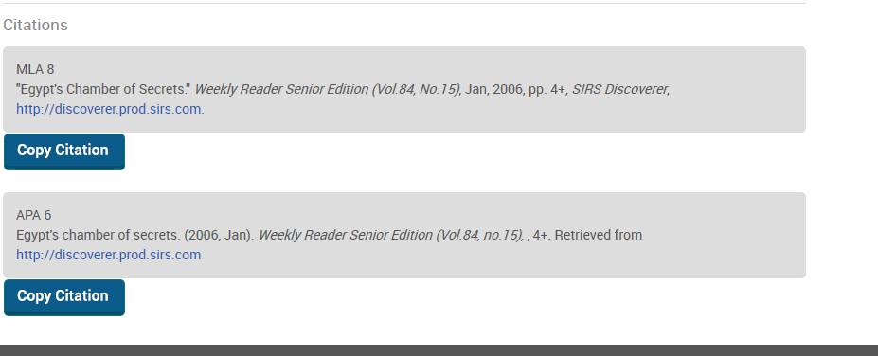
MLA and APA Citations

Slide 21
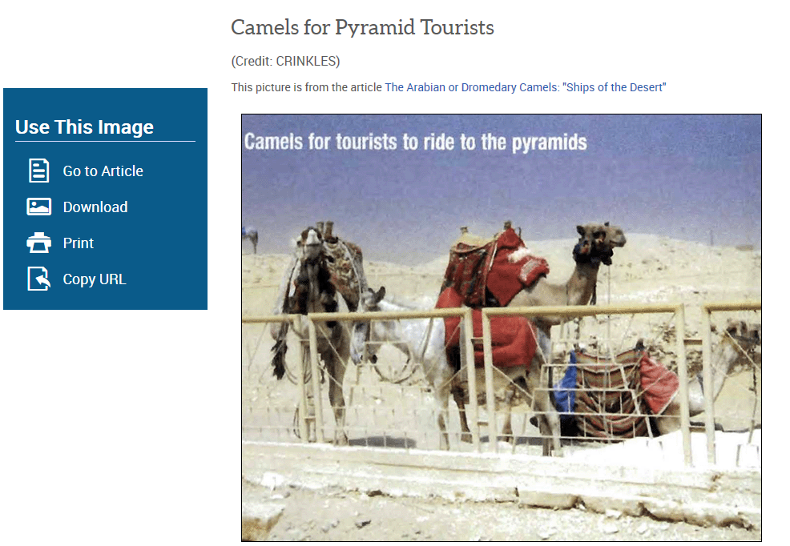
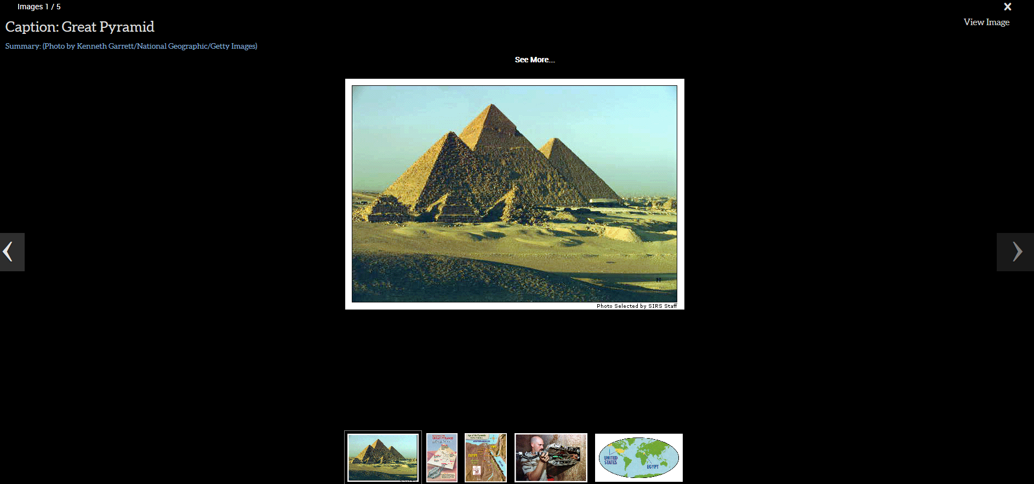
Images
Click on an image thumbnail to see all images associated with an article
Each image contains a link to the associated article
Images can be downloaded or printed
Titles and captions of images are included

Slide 22
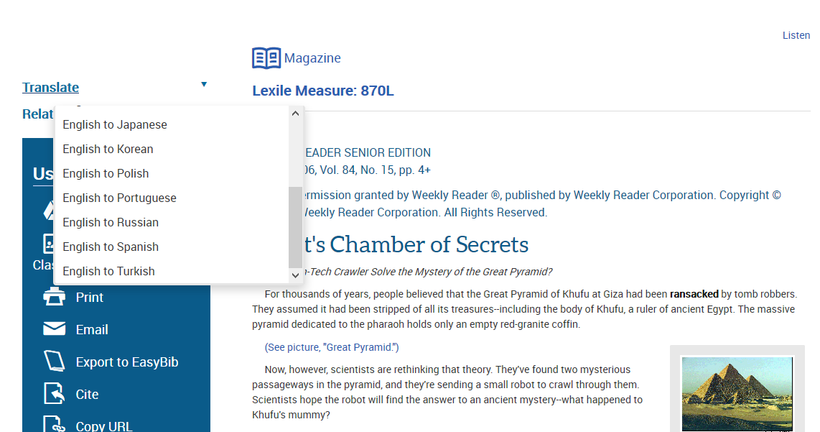
Translation
Chinese (Simplified and Traditional)
French
German
Italian
Japanese
Korean
Polish
Portuguese
Russian
Spanish
Turkish
Notes:
Translations

Slide 23
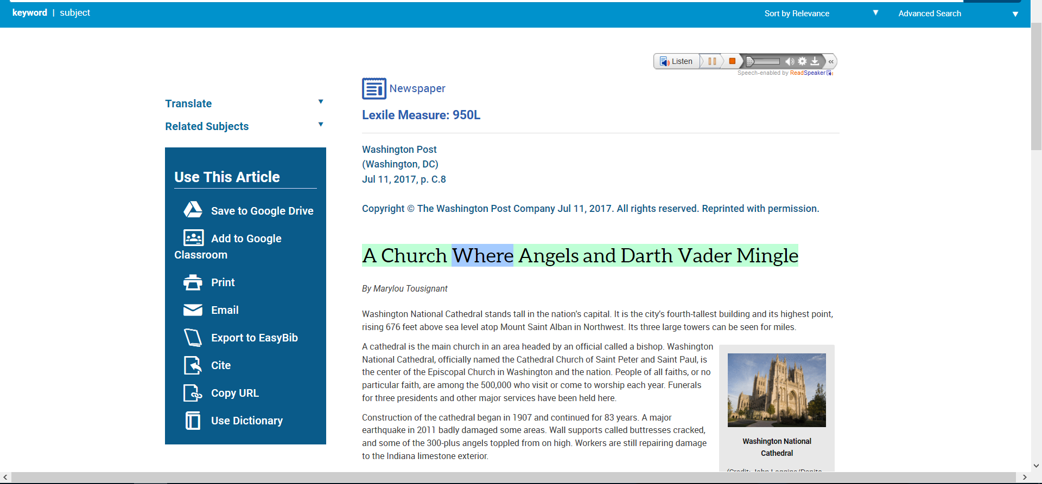
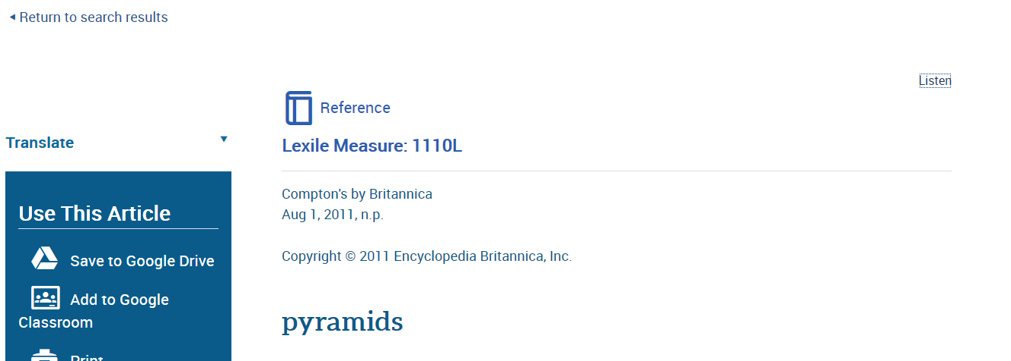
Text to Speech

Slide 24
Browse Subjects

Slide 25
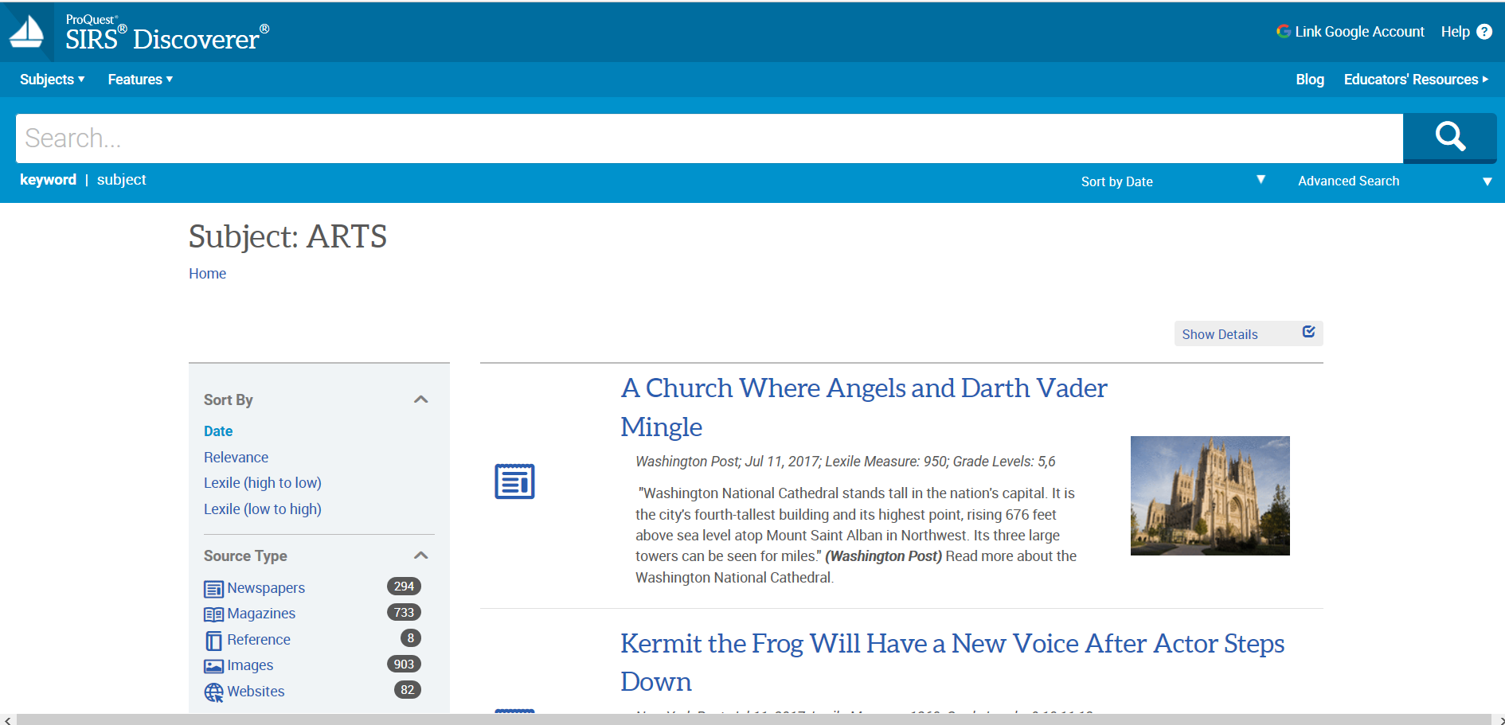
Subject Results—Arts Browse

Slide 26
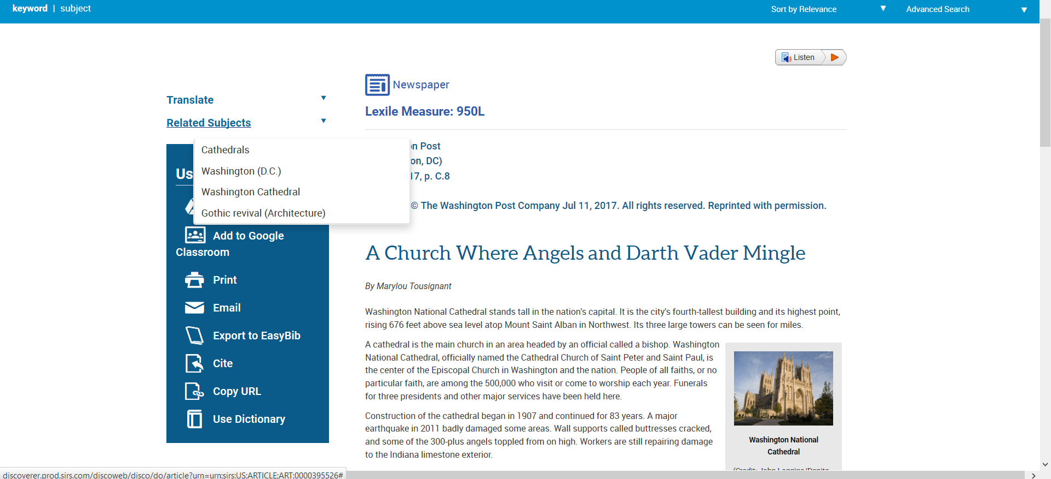
Article View--Related Subjects
Notes:
Related subjects

Slide 27
Explore Features
Notes:
Explore features

Slide 28
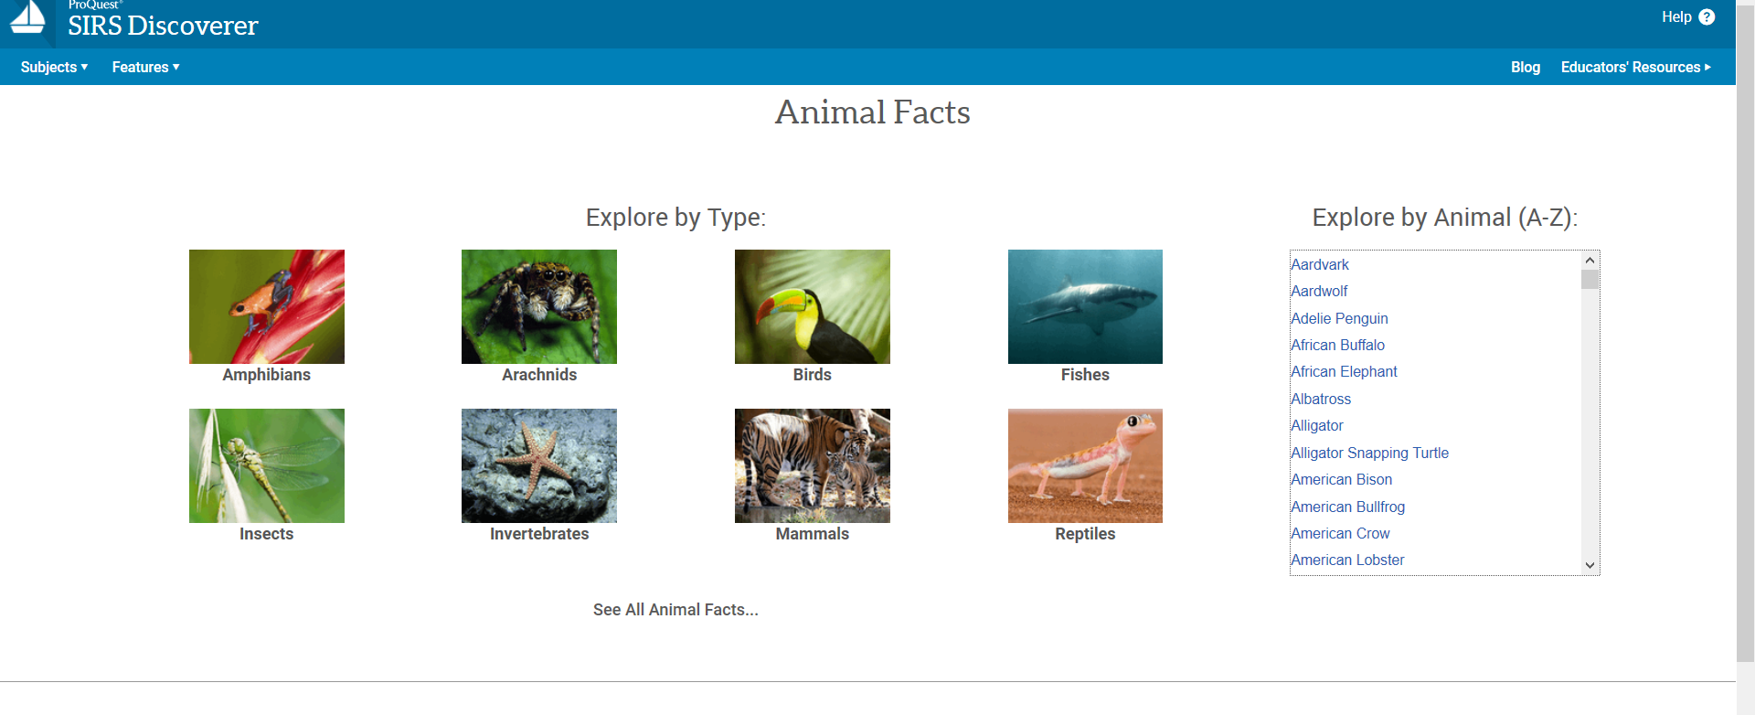
Animal Facts

Slide 29
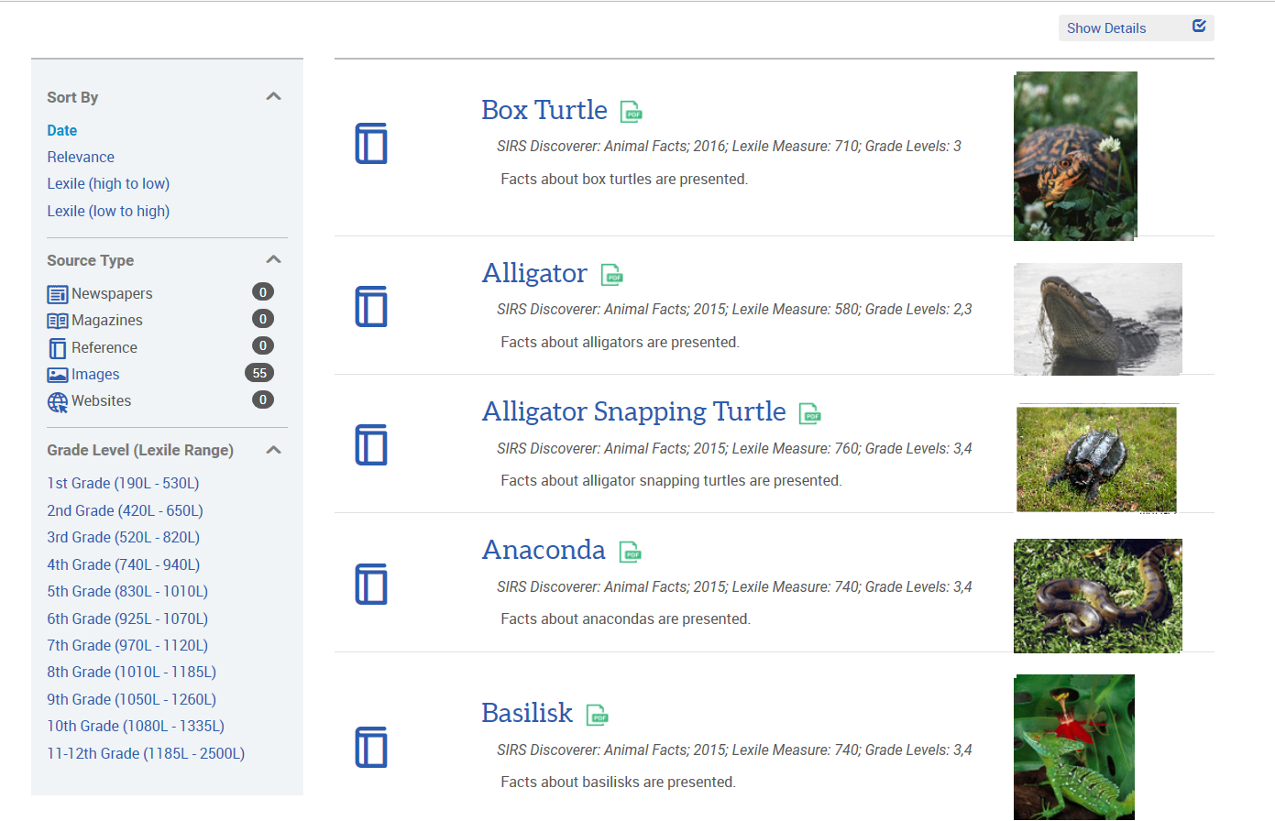
Reptiles Results
Notes:
Most recent first

Slide 30
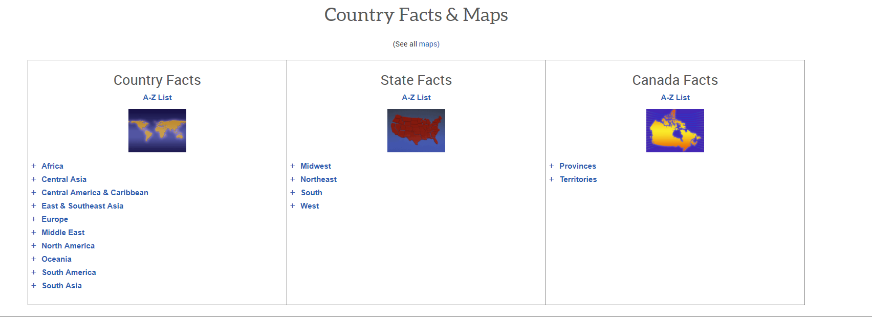
Country Facts & Maps

Slide 31
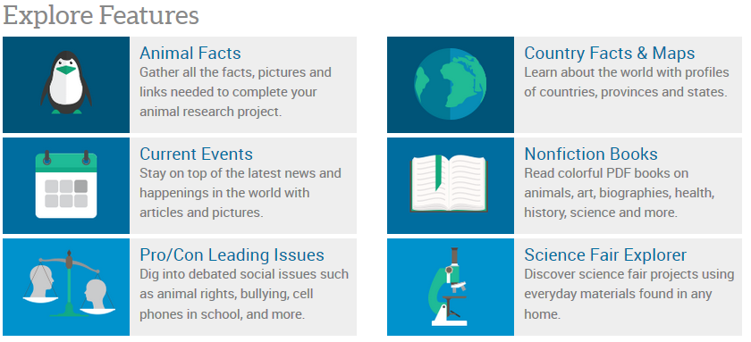
Current Events
Latest news through articles and images
New content added daily
Selected by editors to encourage age-appropriate awareness of current events

Slide 32
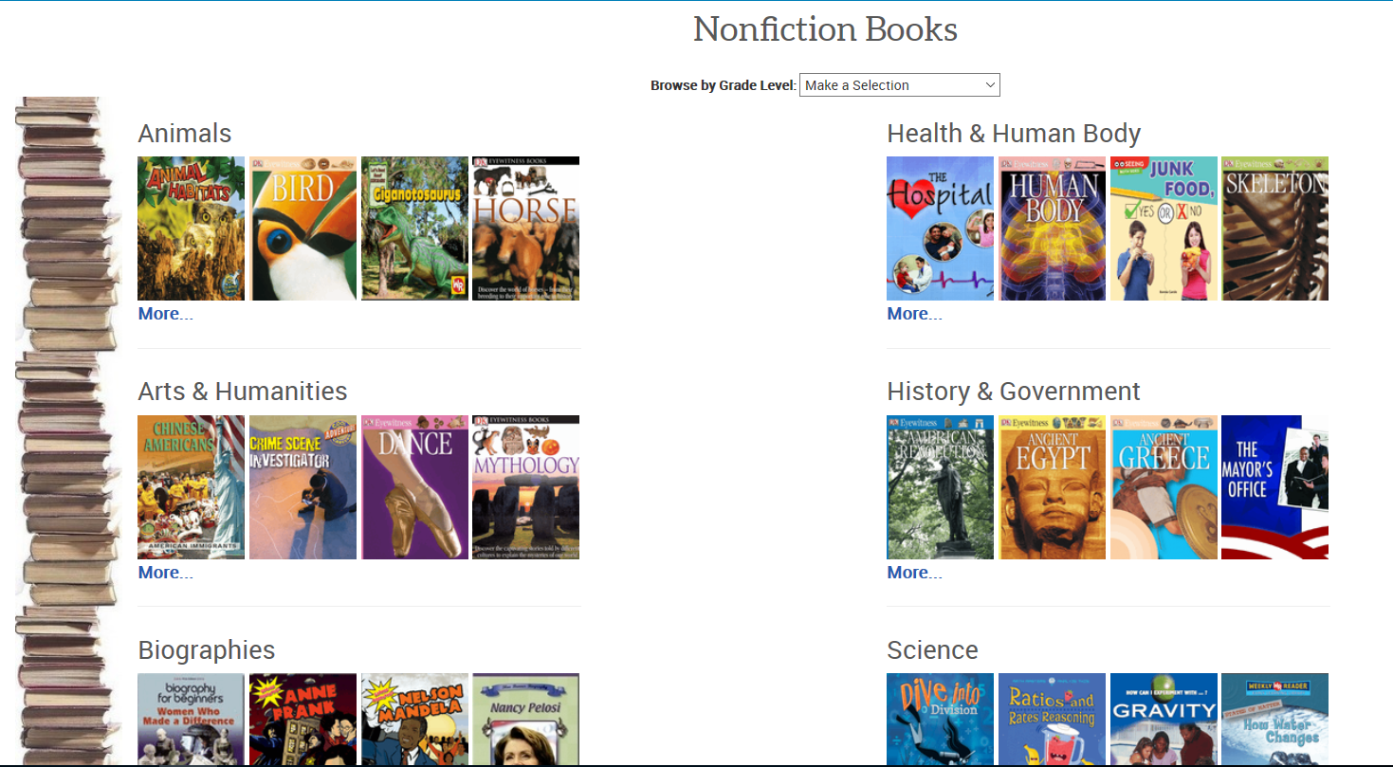
Nonfiction Books
Notes:
Browse by grade level

Slide 33
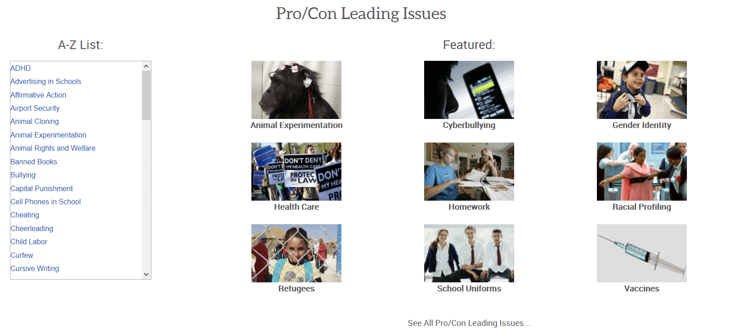
Pro/Con Leading Issues

Slide 34
Science Fair Explorer

Slide 35
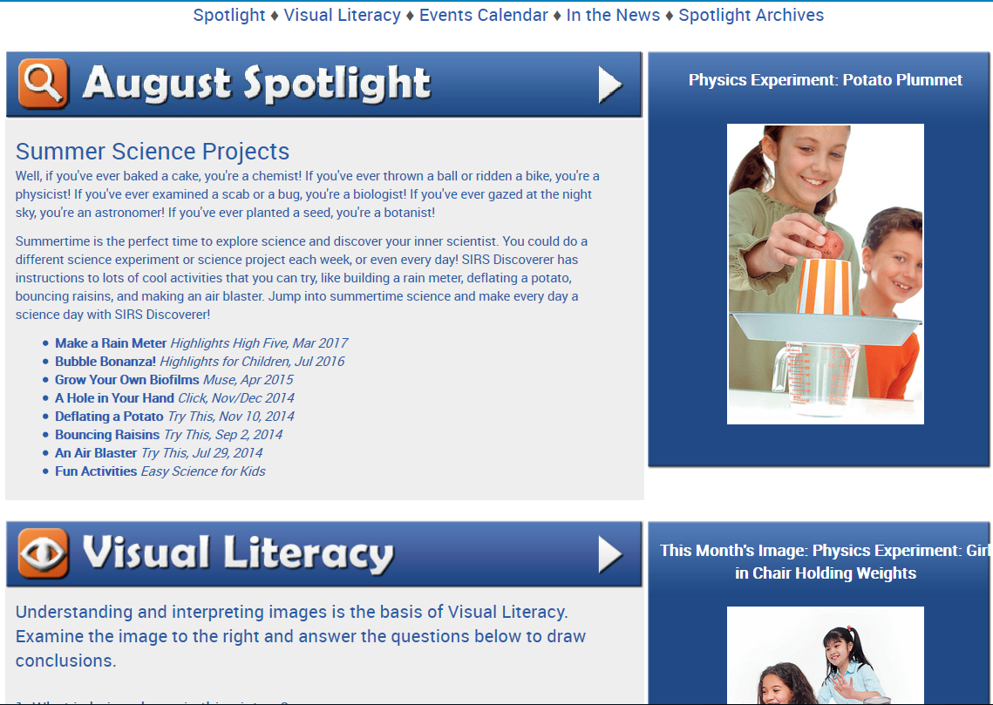
Spotlight of the Month
Notes:
Also has an archive

Slide 36
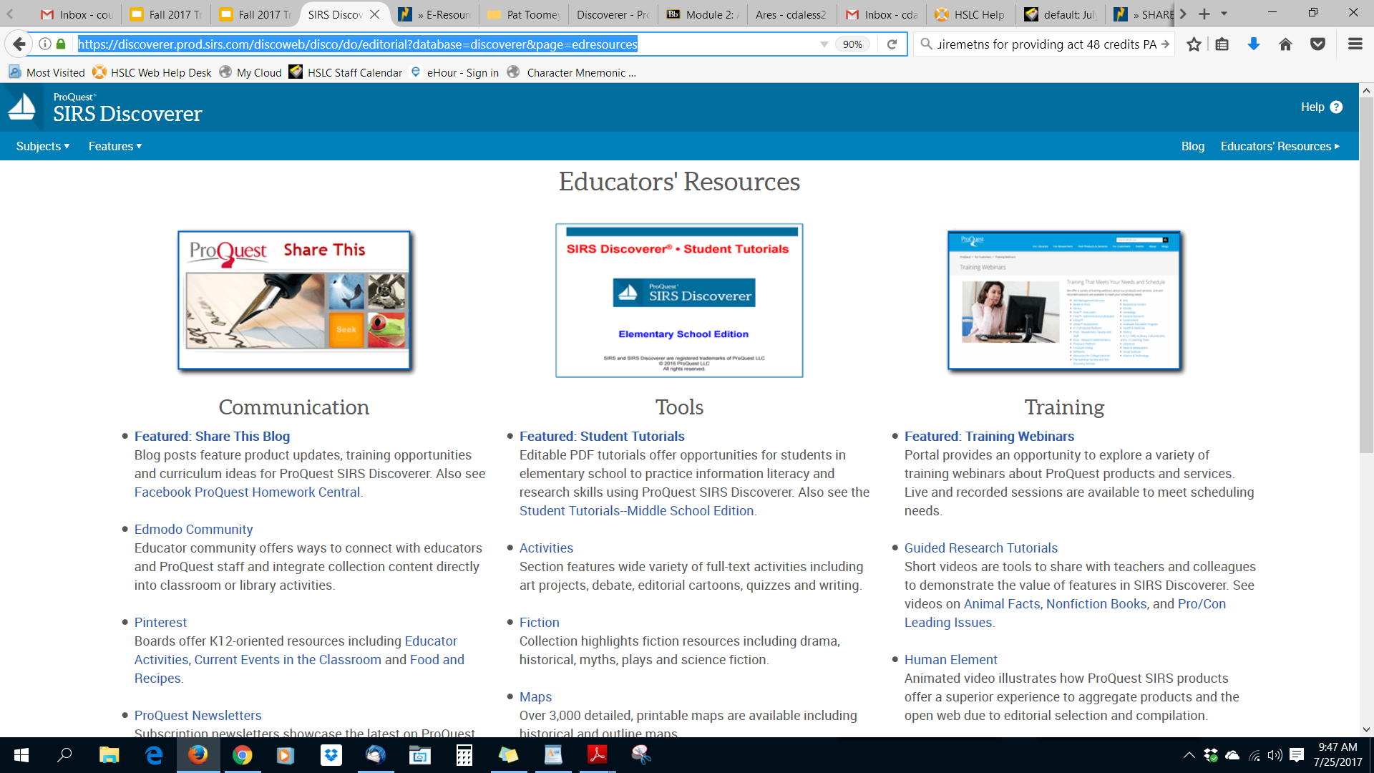
Educators’ Resources

Slide 37
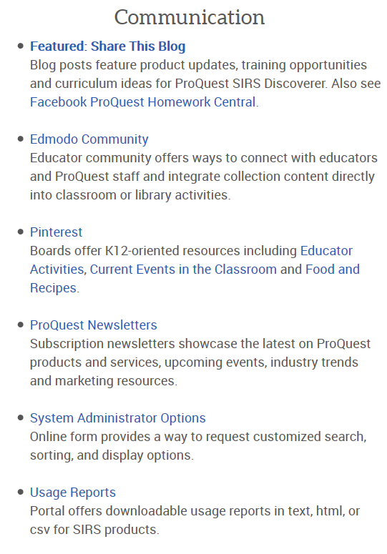
Educators’ Resources: Communication

Slide 38
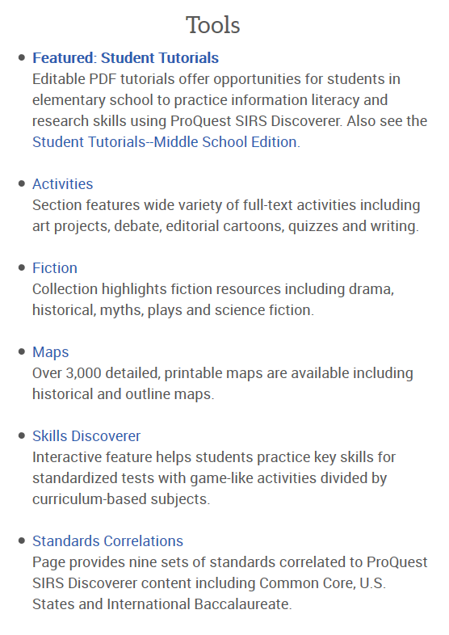
Educators’ Resources: Tools

Slide 39
Educators’ Resources: Training

Slide 40
SIRS Discoverer Demo

Slide 41
Hands-on Time
SIRS Discoverer
Choose one of the topics under the “Explore Features” category.
Check out the featured “Spotlight on” category, and explore the contents available.
Look at the Pro/Con Leading Issues site, choose a topic, and examine the information available. Think about how you could use this portion of SIRS in your library.

Slide 42
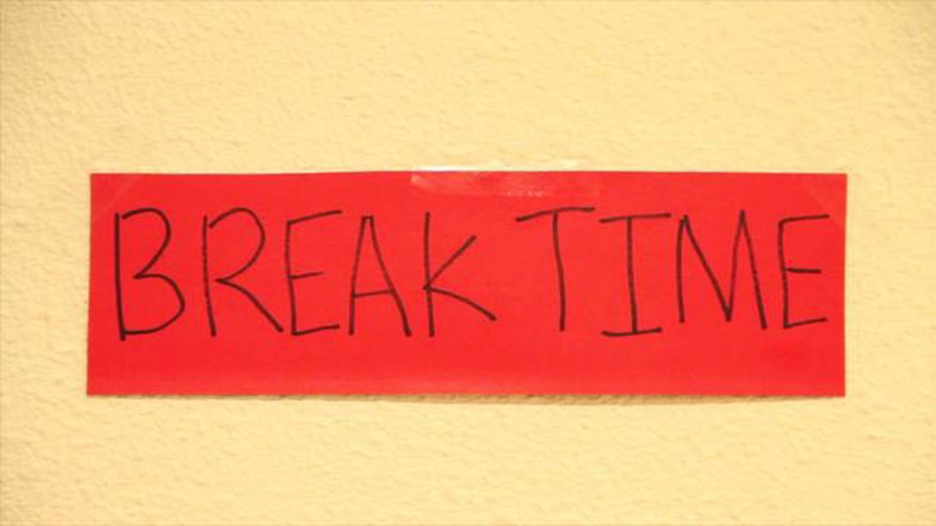
Break—15 minutes

Slide 43
EBSCO Explora
Explora is EBSCO's interface for Schools and Public Libraries. Designed to meet the unique needs of its users, Explora supports both student research and classroom instruction with the following features:
Simple search that quickly delivers relevant results
Easy-to-browse categories organized by popular topic
Topic overviews that provide students with a starting point for research
Colorful, mobile-friendly design with feature areas that provide context to students
Reading level indicators (Lexile® Measures) to simplify discovery of grade-appropriate content
Text-to-speech for HTML articles to assist struggling readers or those learning English
Curriculum Standards Module to help educators correlate EBSCO content quickly and easily to Common Core, state- or province-specific curriculum standards
http://support.ebscohost.com/help/

Slide 44
Content
Articles, essays, and primary source documents
60,000 videos from the Associated Press
Full-text translation in more than 30 languages
Google Classroom integration
Lesson plans, support materials, and professional development resources

Slide 45
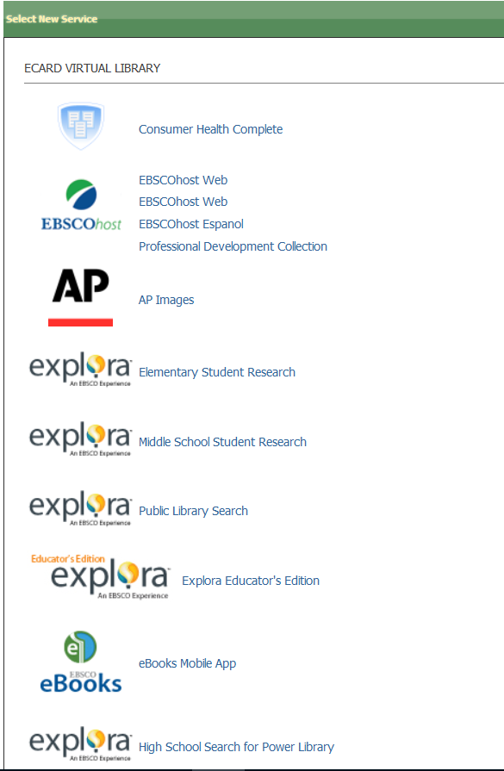
Explora
Accessible from:
POWER Library e-Resources listing
EBSCO menu on POWER Library e-Resources menu
Elementary Student Research
Middle School Student Research
Public Library Search
Explora Educator’s Edition
High School Search

Slide 46
Explora icon
The Explora icon is on every page and allows for easy navigation back to homepage.

Slide 47
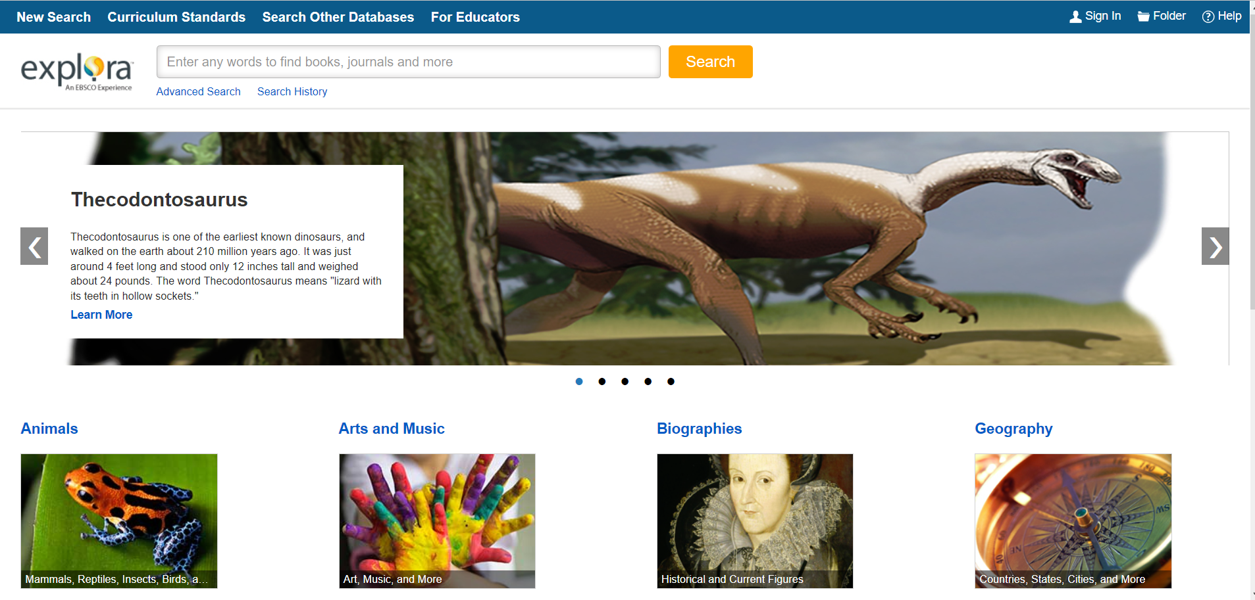
Explora—Elementary Student Research
New Search
Curriculum Standards
Search Other Databases
For Educators
Help
Folder
Advanced Search
Search History
Image Carousel
Subject Search

Slide 48
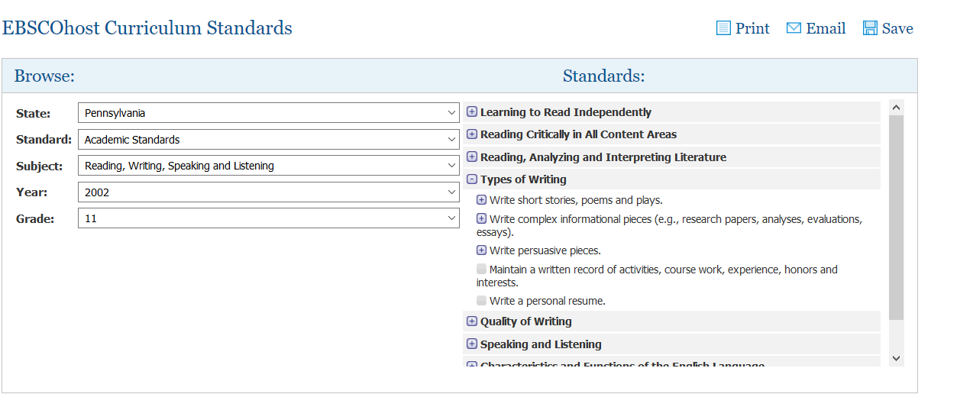
Curriculum Standards

Slide 49
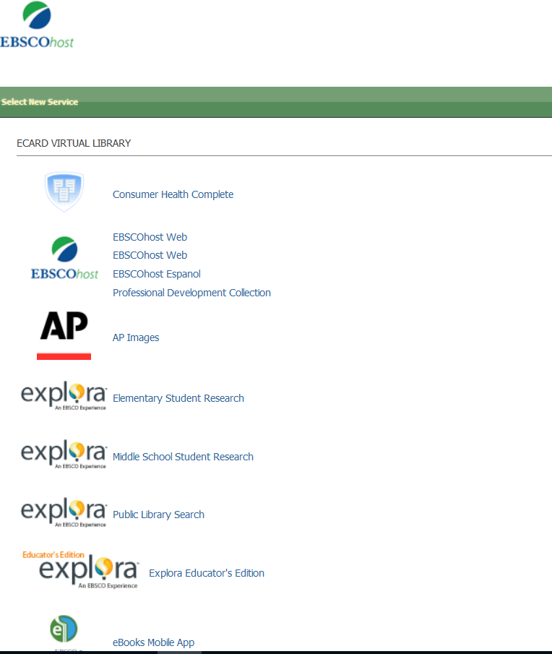
Search Other Databases

Slide 50
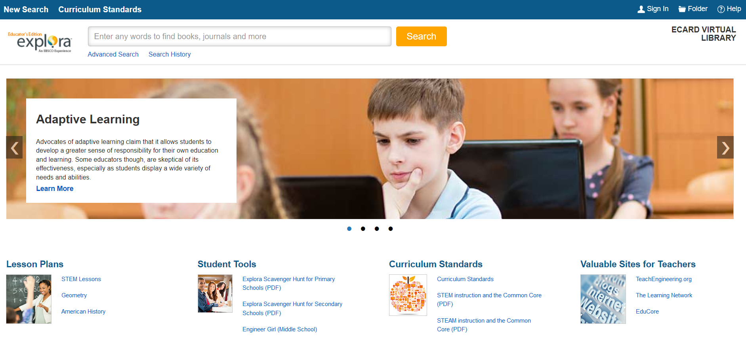
For Educators

Slide 51
Image Carousel
Browse the image carousel
Click on “Learn More” to access a list of relevant search results

Slide 52
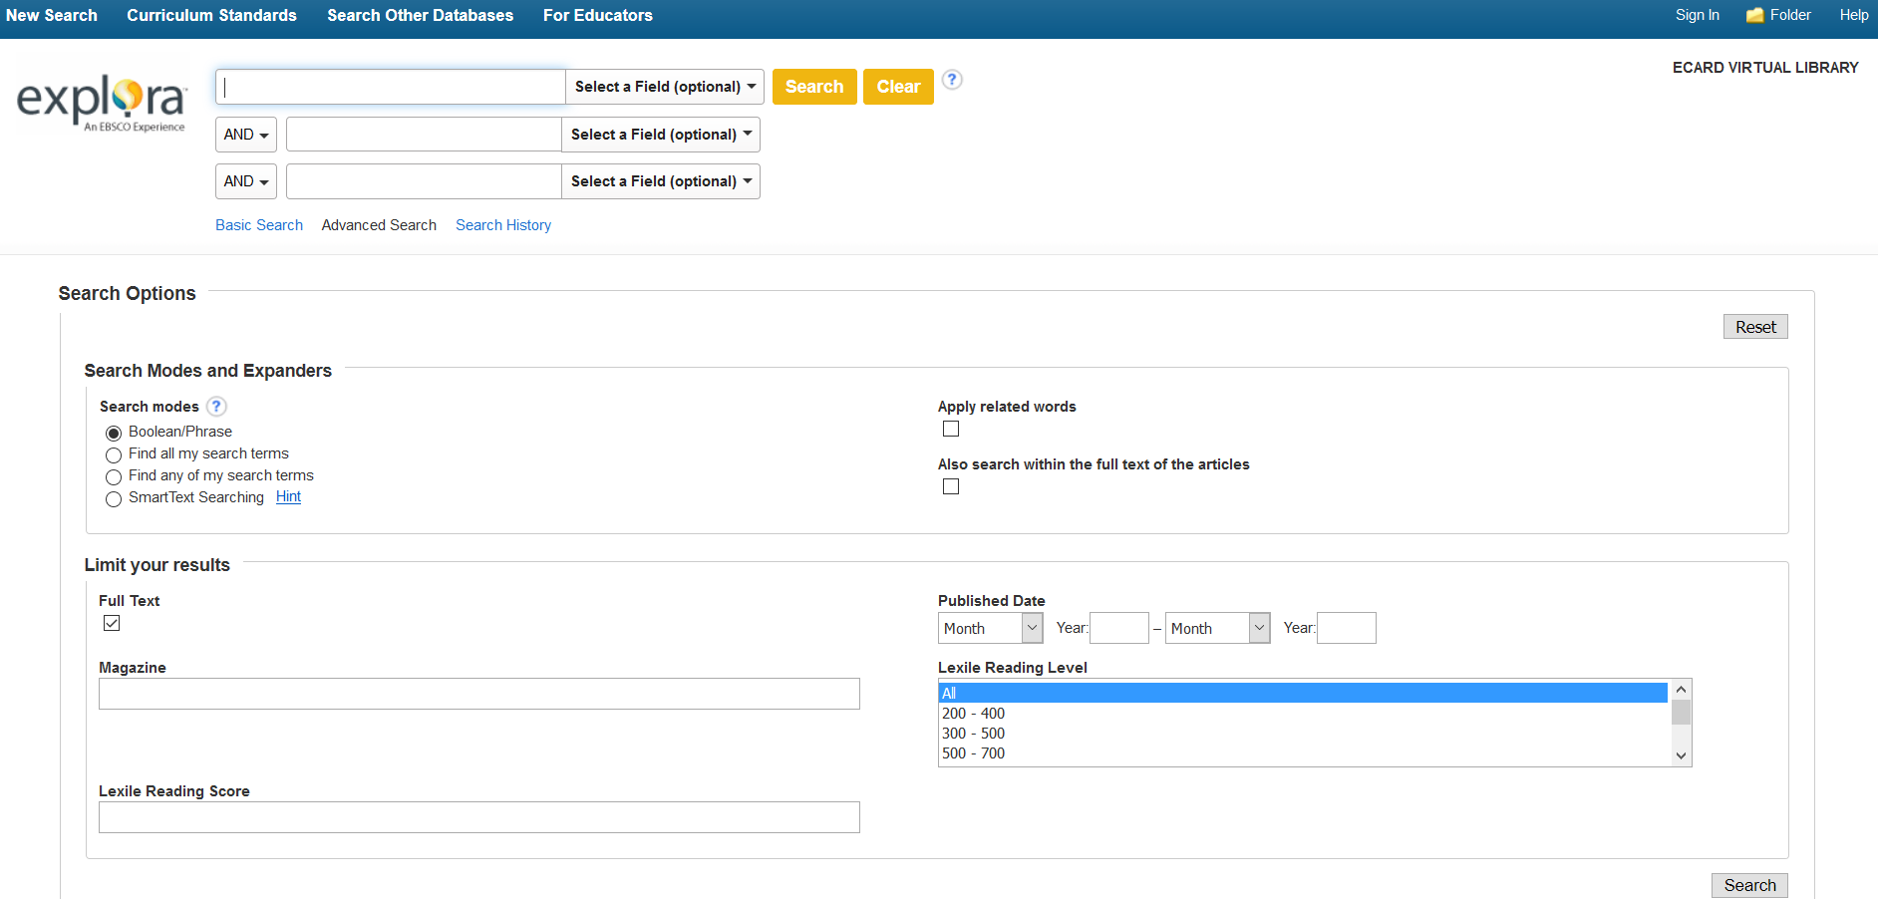
Advanced Search

Slide 53
Search History
Notes:
Search history disappears after closing out of browser

Slide 54
Search--Keyword
Notes:
Autocomplete will anticipate terms

Slide 55
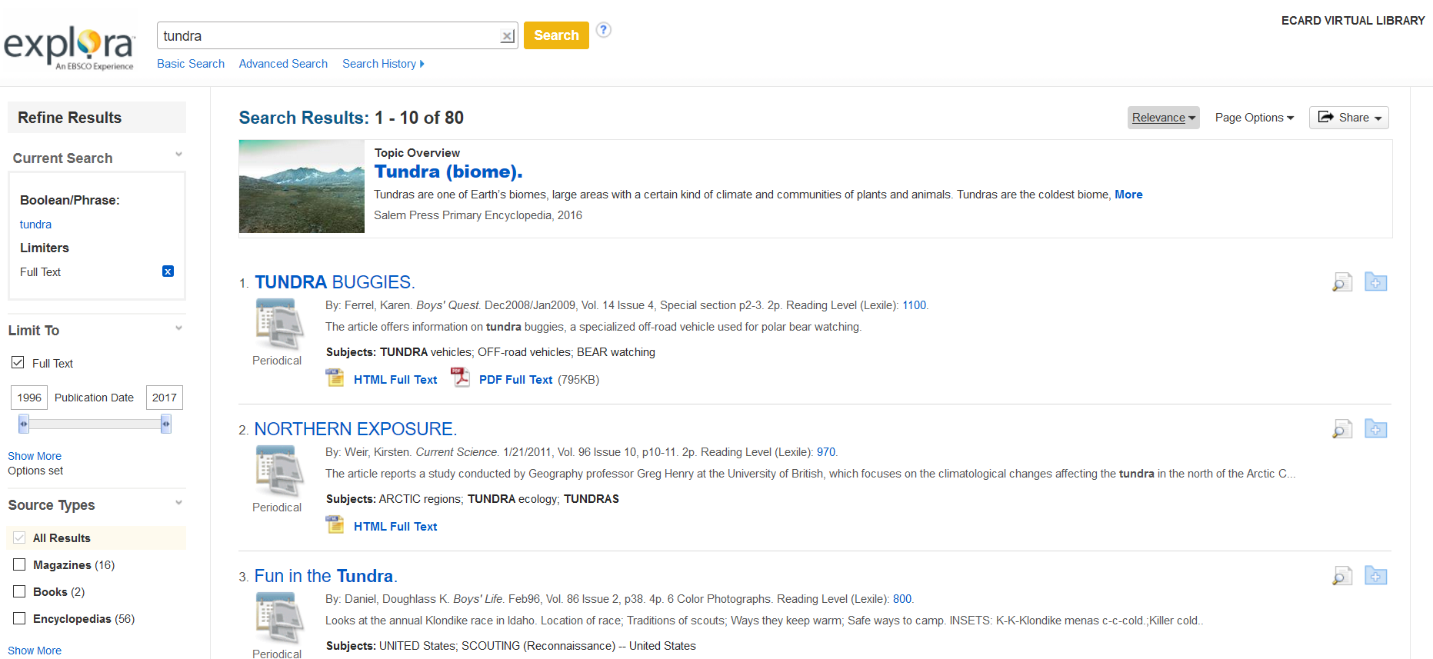
Search Results

Slide 56
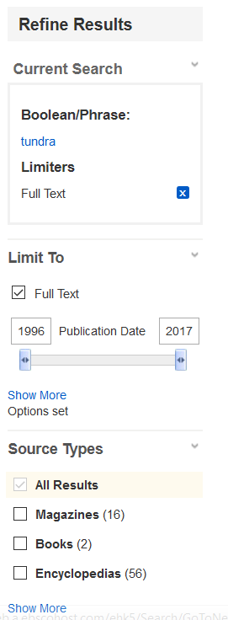
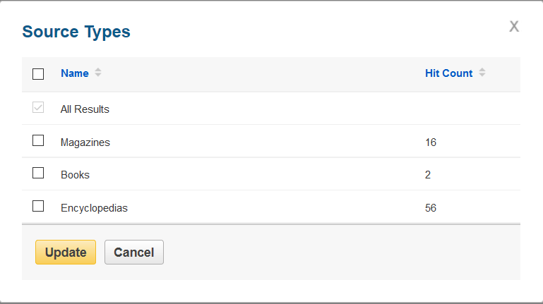
Search Results—Refine Results

Slide 57
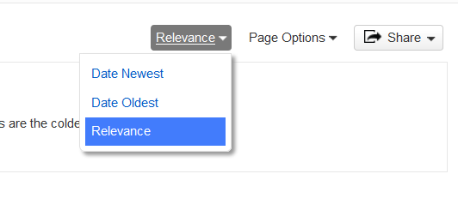
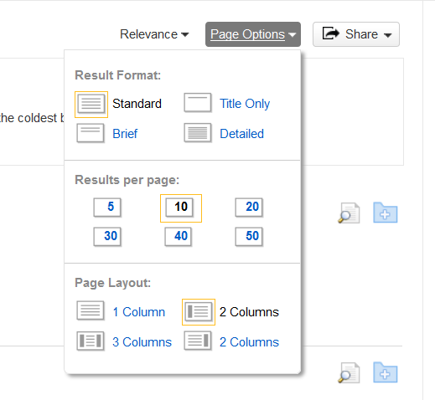
Search Results—Relevance and Page Options

Slide 58
Results List—Article Information
Title information, including Lexile level
Subjects
2 options: PDF or HTML full text view
Article preview information
Save and share

Slide 59
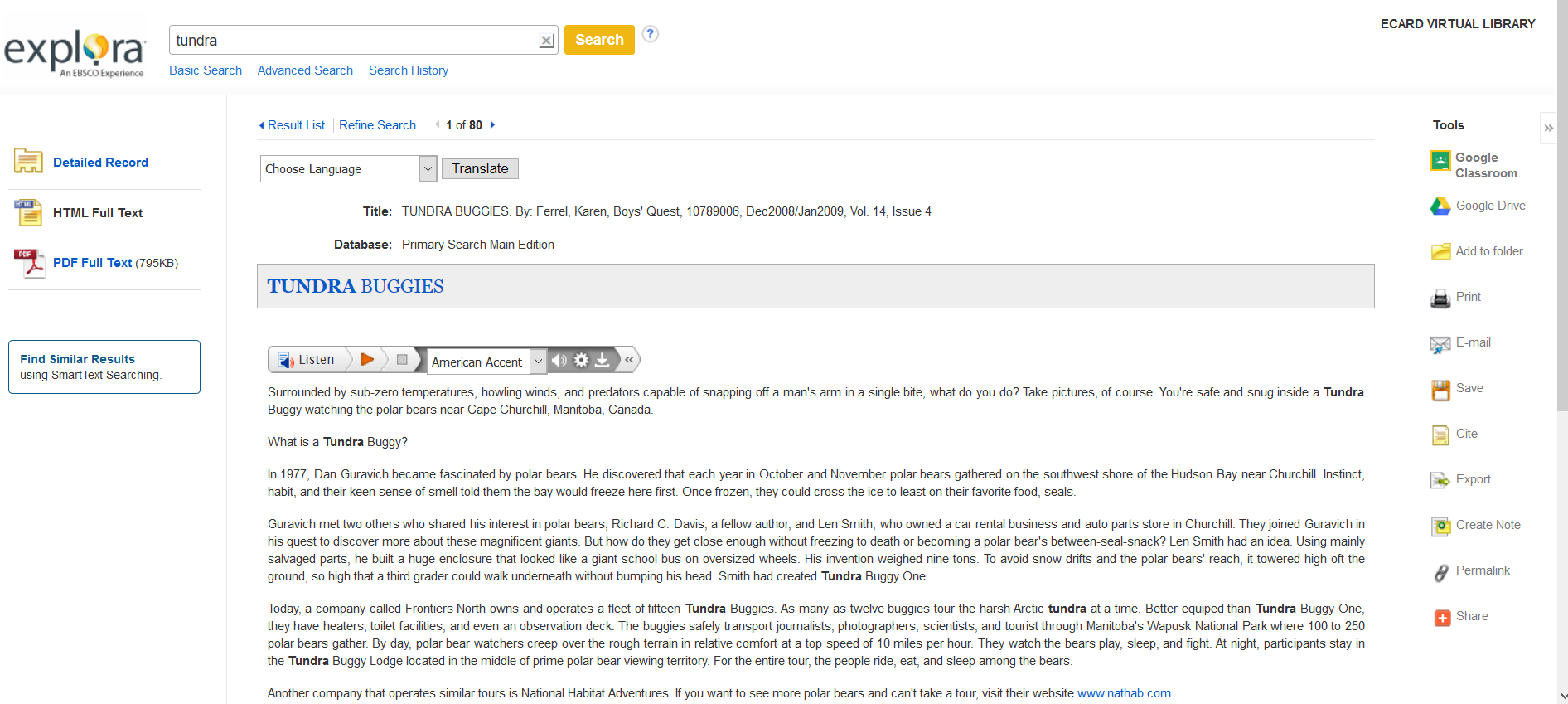
HTML Full-text View

Slide 60
Translate
34 language options available

Slide 61
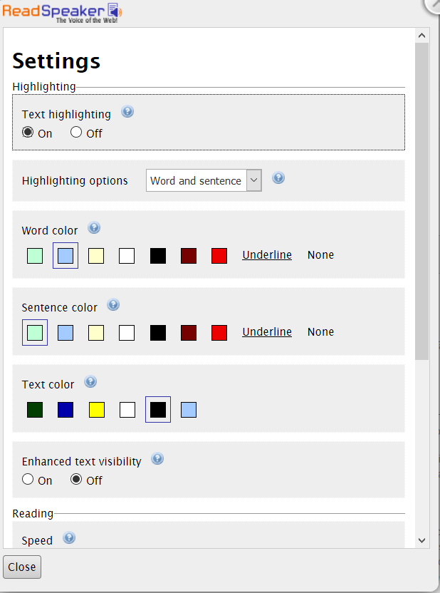
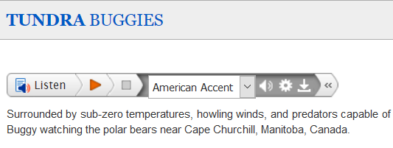
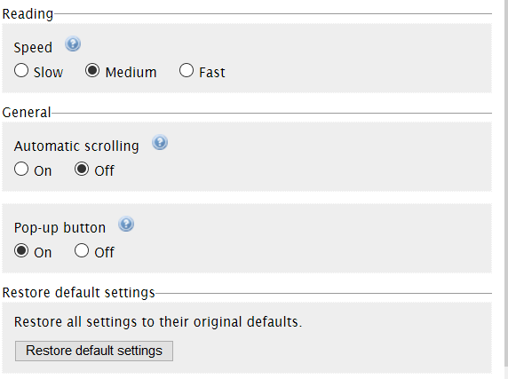
Text-to-Speech Settings

Slide 62
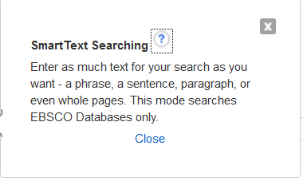
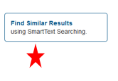
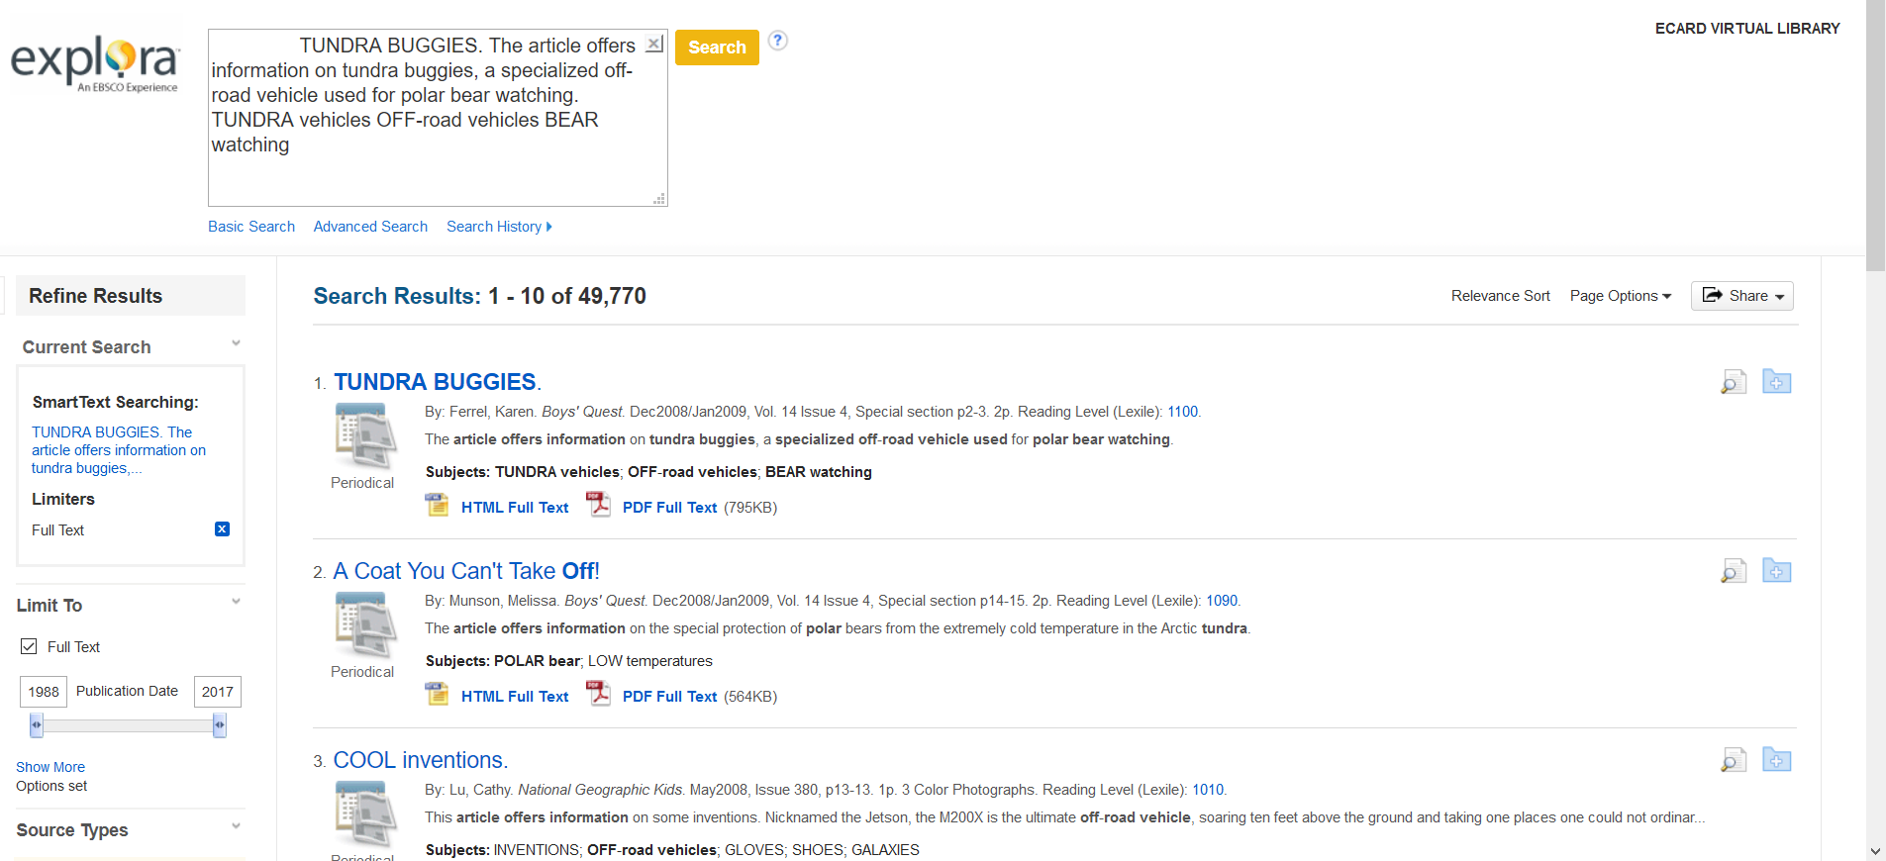
Find Similar Results

Slide 63
Browse by Category

Slide 64
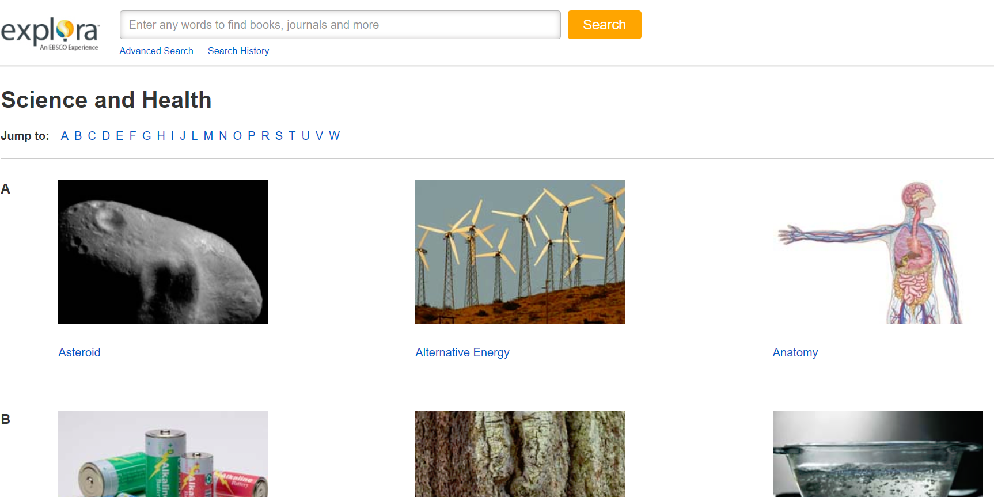
Choosing a Category

Slide 65
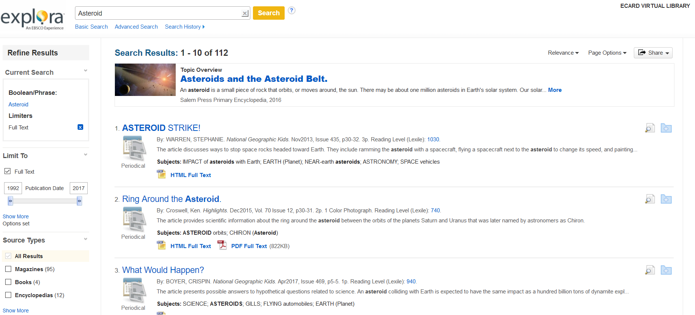
Category Browse—Picking a Topic

Slide 66
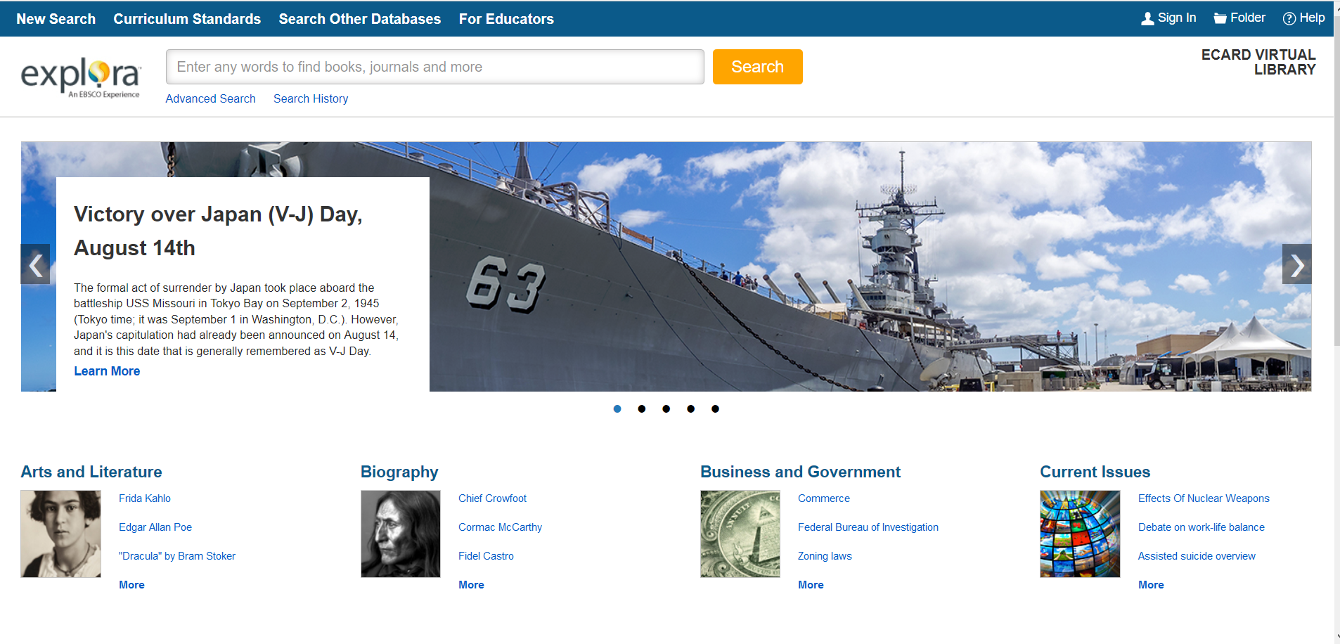
Explora Middle School Student Research
Notes:
Same features as Elementary Student Search—carousel, same tools, search functions, category browse

Slide 67
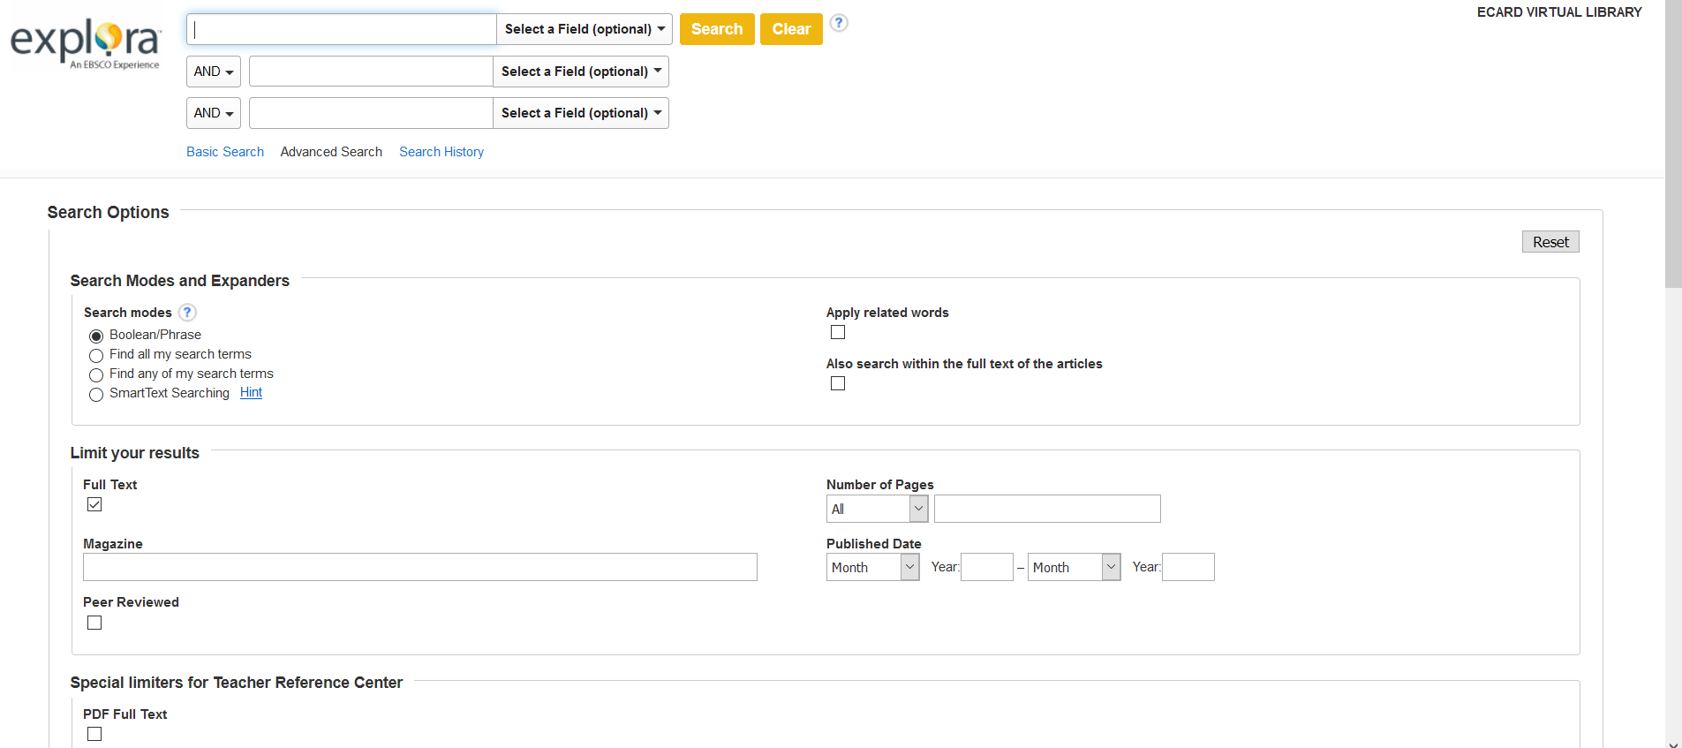
Explora Middle School—Advanced Search
Notes:
More robust than elementary, additional limiters

Slide 68
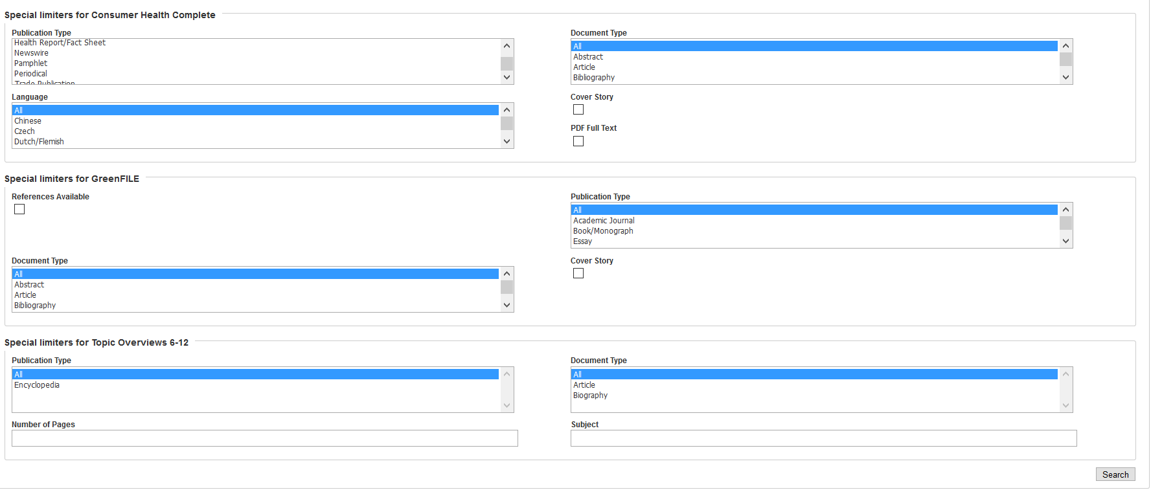
Explora Middle School—Advanced Search

Slide 69
Search and Search Results
Same results listing as Explora Elementary Student Research
Refine results
Text-to-speech
Save and share
Translate
Title information
Sort by options

Slide 70
Browse by Category
8 categories with 3 featured topics
“More” for additional topics

Slide 71
Browse by Category--Topics

Slide 72
Explora High School Student Research
Notes:
Link points to Public Library Search

Slide 73
Search and Search Results
Same results listing as Explora Elementary Student Research
Refine results
Text-to-speech
Save and share
Translate
Title information
Sort by options
Advanced Search features the same limiters as Middle School Student Research

Slide 74
Explora Educator’s Edition
Notes:
Image carousel, search, advanced search, category browse, curriculum standards

Slide 75
Curriculum Standards

Slide 76
Image Carousel
Browse the image carousel
Click on “Learn More” to access a list of relevant search results

Slide 77
Advanced Search

Slide 78
Search Results

Slide 79
Article View—HTML Full Text

Slide 80
Browse by Category

Slide 81
Lesson Plans
Notes:
Full text not available for everything, not many ready-made and viewable lesson plans

Slide 82
Lesson Plans from EBSCO Explora Website
https://help.ebsco.com/interfaces/Explora/Resources_for_Educators

Slide 83
Sample Lesson Plan from EBSCO
https://help.ebsco.com/interfaces/Explora/Resources_for_Educators/Butterflies_and_Camouflage

Slide 84
Student Tools

Slide 85
Curriculum Standards

Slide 86
Valuable Sites for Teachers

Slide 87
Explora Help Webpage—Additional Resources
https://help.ebsco.com/interfaces/Explora

Slide 88
Explora Public Libraries

Slide 89
Advanced Search

Slide 90
Browse by Category

Slide 91
Browse by Category--Topics

Slide 92
Search Results

Slide 93
Article View

Slide 94
Wrap Up
SIRS Discoverer
Great for specialized topic research
State and country research
Pro/Con issues
Science Fair projects
Easily incorporate SIRS Discoverer features into library lessons
EBSCO Explora
Great general reference resource for research
Expora Public Libraries edition is great for general public use for adult patrons, as well as in schools.

Slide 95
Questions?

Slide 96
Hands-on Time
EBSCO Explora Databases
Try to create a folder and practicing saving articles (email not needed).
Find the Explora scavenger hunts under “Explora Educator’s Edition” and choose one to complete.
Explore some of the differences between Explora for elementary, middle, and high schools.

